Slide 1
Lab # 5
OpenMP capstone test (20 minutes)
MPI syllabus as per course outline
MPI installation on Ubuntu (posted on Google Classroom Sept. 2023)
Shared vs Distributed Memory
Programming Distributed Memory (message passing) Systems
MPI Programming
Basic Program
MPI Send and MPI Receive API
Calculating Pi using MPI
Write MPI program for a word problem.

Slide 2
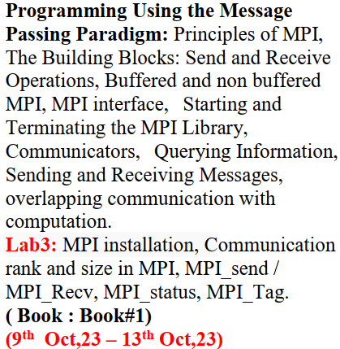
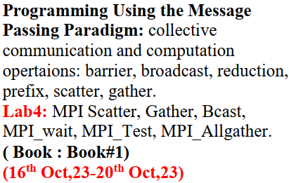
MPI Syllabus (as per Course outline)

Slide 3
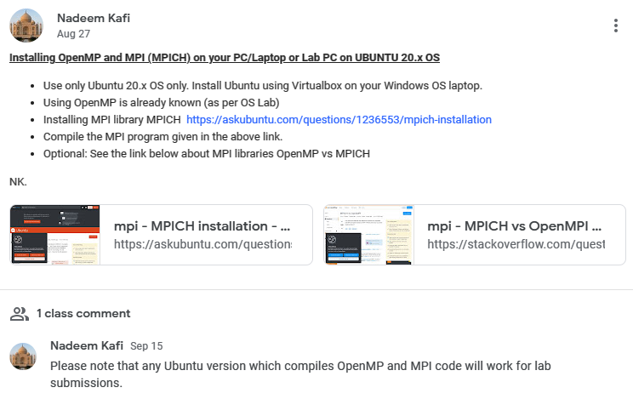
Show it to your TA at the time of Semester Project DEMO

Slide 4

MPI Installation … both flavors MPICH/OpenMPI
MPICH - MPICH is supposed to be high-quality reference implementation of the latest MPI standard and the basis for derivative implementations to meet special purpose needs.
Open-MPI targets the common case, both in terms of usage and network conduits.

Slide 5
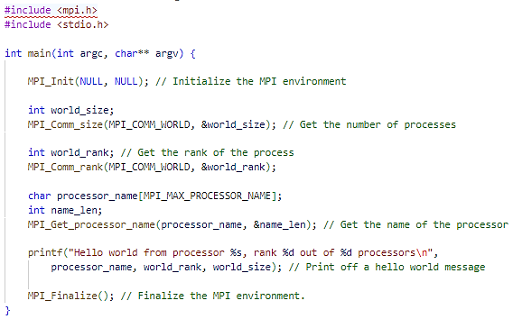
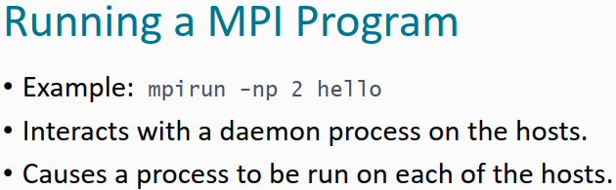

Slide 6
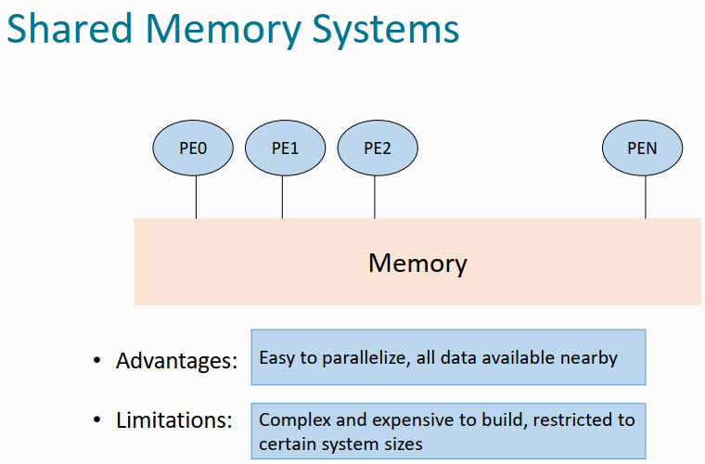

Slide 7
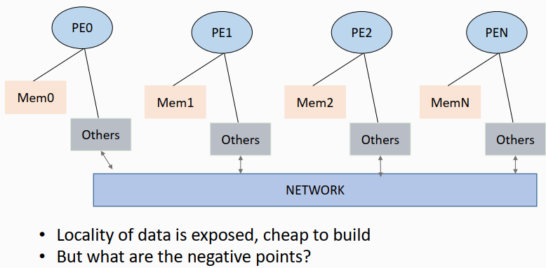

Slide 8
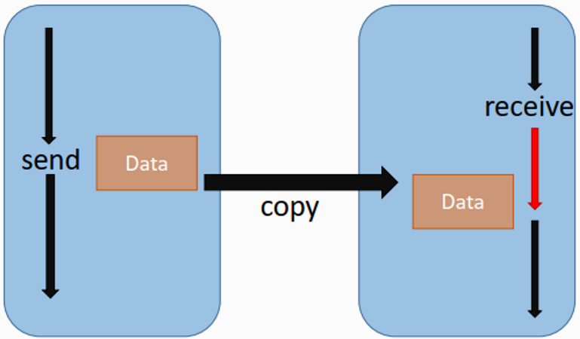
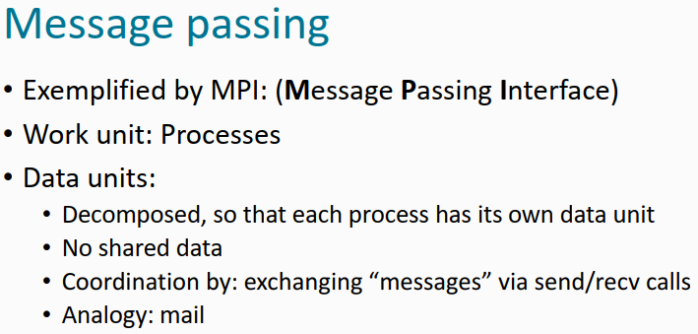

Slide 9
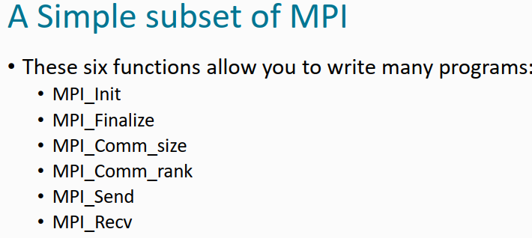
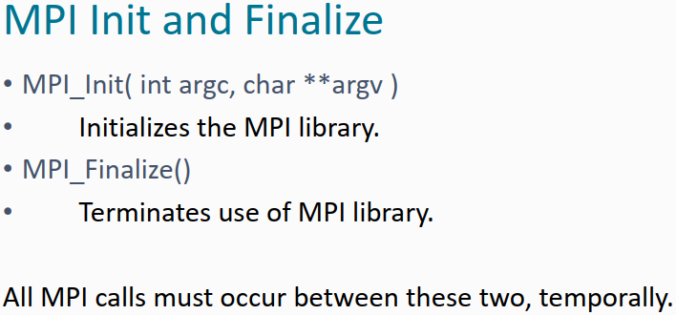
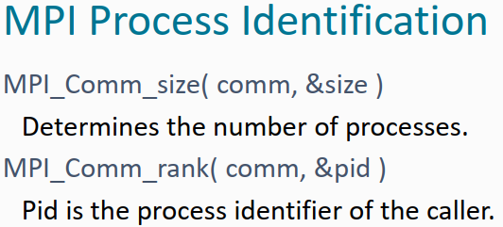

Slide 10
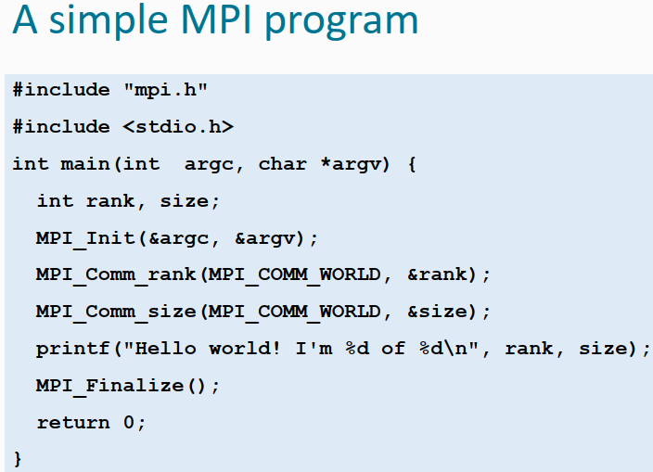

Slide 11
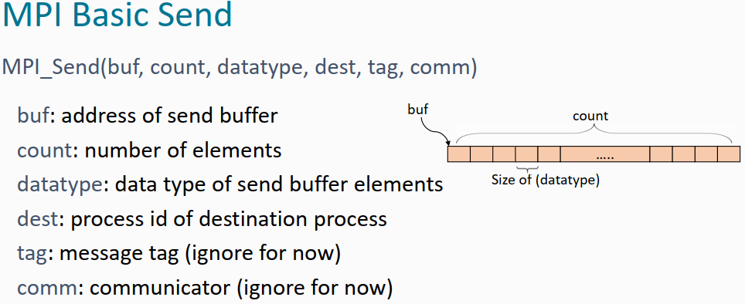

Slide 12
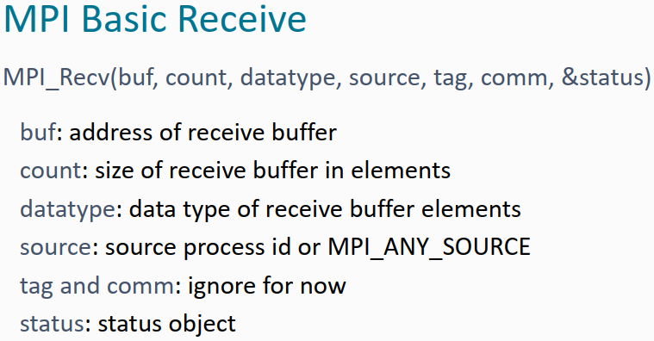

Slide 13
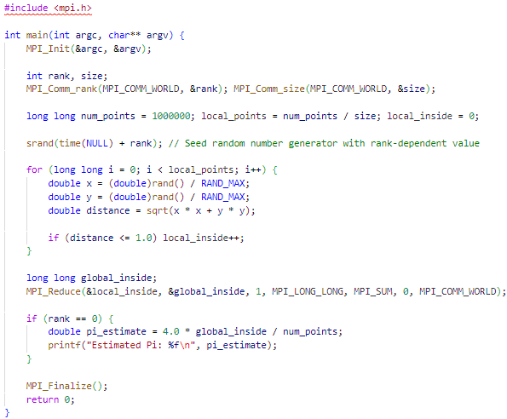
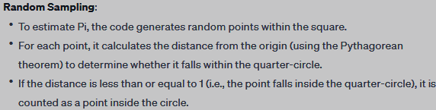
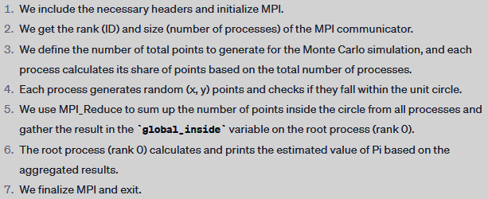

Slide 14
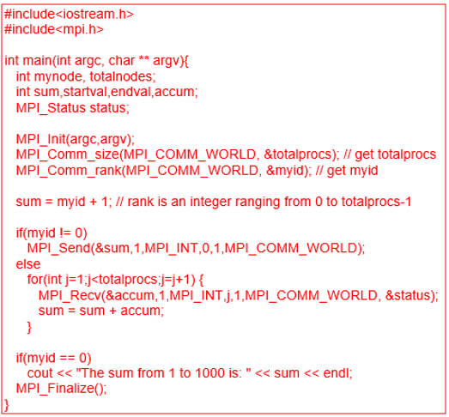
Write compact readable MPI C code to sum up all the numbers from 1 to 1000.
Use 1000 processes, where process 0 will print the sum. Note:
Explain all MPI functions after the code. Ensure that your code computes the correct sum.

